Slide 2
Controller design and tuning
Wind Turbine Control Online Course
Alan Wai Hou Lio
Researcher, DTU Wind Energy
wali@dtu.dk

Slide 3
Learning objectives
After this session you should be able to:
Understand how to maximise the power captured by a turbine
Describe what types of controllers are used in Region 2
Understand the design philosophy behind a generator torque controller in Region 2
Calculate the torque controller gain in Region 2

Slide 4
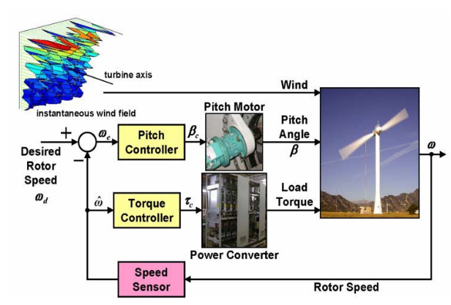
Let’s control a wind turbine
Three actuators:
Blade pitch motor
Generator torque converter
Yaw motor
Sensors:
Generator/Rotor speed sensor
Anemometers
More actuators and sensors available for large turbine
Actuators: Trailing-edge flap
Sensors: LiDAR, tower and blade load sensors
Source: Pao et al. 2009

Slide 5
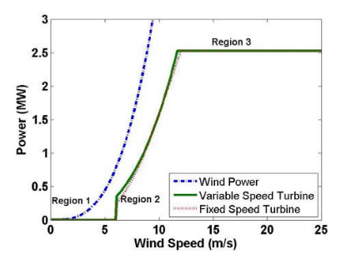


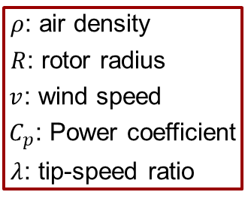
Power in the wind
Power available in the wind
$P=\frac{1}{2}ρπR^{2}v^{3}$
Power captured by wind turbine
$P=\frac{1}{2}ρπR^{2}v^{3}C_{p}\left(λ,θ\right)$
$ρ$: air density
$R$: rotor radius
$v$: wind speed
$C_{p}$: Power coefficient
$λ$: tip-speed ratio
Region 1
$λ=\frac{ΩR}{v}$ $Ω:$ rotor speed
Control Objectives:
(1) Optimize power production at below rated wind speeds (region 1)
(2) Limit power and loads at above rated wind speeds (region 3)

Slide 6
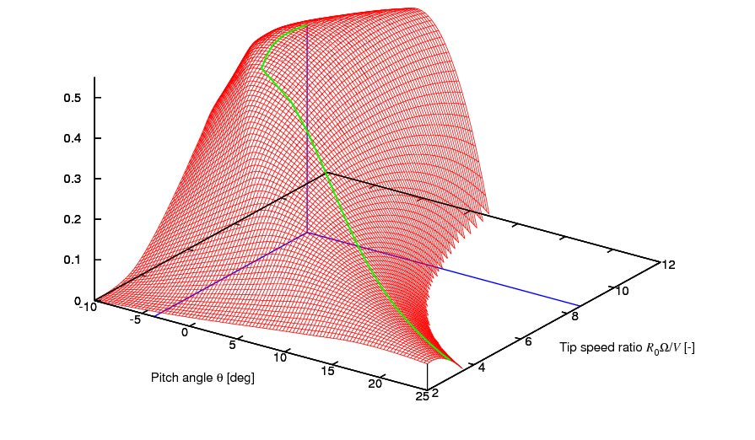



Variable-speed Pitch-regulated control
Region 2
Region 2.5
Region 3
Region 2.5
Region 2
Cp
Region 3
$$λ_{opt}$$
$$θ_{opt}$$
$$P=\frac{1}{2}ρπR^{2}v^{3}C_{p}\left(λ,θ\right)$$

Slide 7
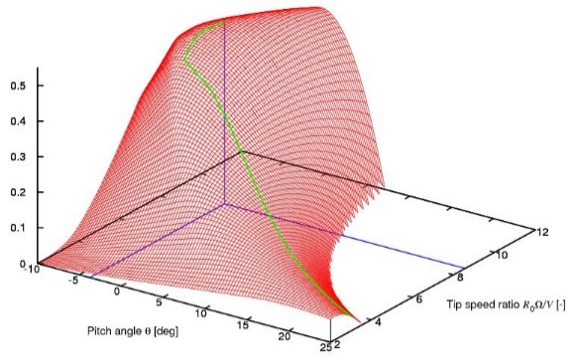


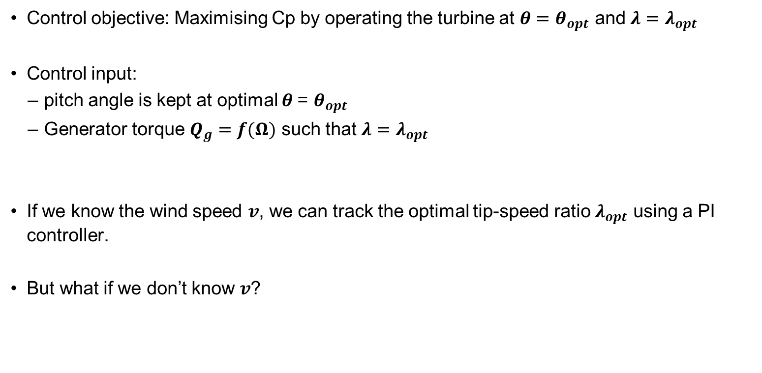




Region 2 controller design
Control objective: Maximising Cp by operating the turbine at ${θ=θ}_{opt}$ and ${λ=λ}_{opt}$
Control input:
pitch angle is kept at optimal $θ$= $θ_{opt}$
Generator torque $Q_{g}=f(Ω)$ such that ${λ=λ}_{opt}$
If we know the wind speed $v$, we can track the optimal tip-speed ratio $λ_{opt}$ using a PI controller.
But what if we don’t know $v$?
$$λ=ΩR/v$$
PI Controller
$$Q_{g}$$
Wind turbine
$$Ω$$
$$λ_{opt }$$
$$λ=ΩR/v$$
$$v$$

Slide 8
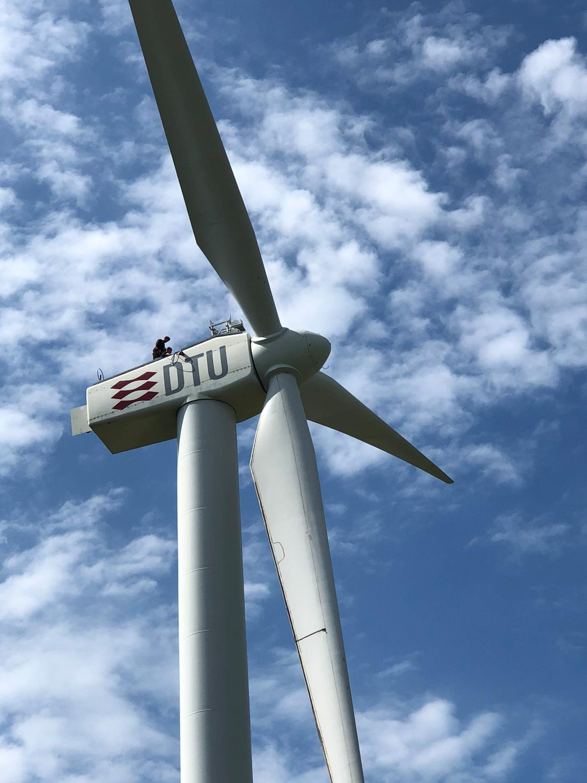

Region 2 Problem with wind measurement
Wind speed measurement $v$
Wind cup: subject to noise
Lidar: expensive
LiDAR
Wind anemometer
Can we track the optimal Cp (or optimal tip-speed ratio) without using the wind speed measurement?

Slide 9


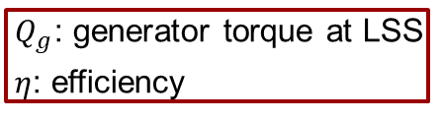


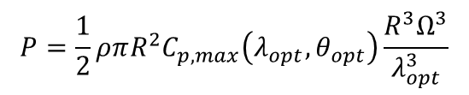

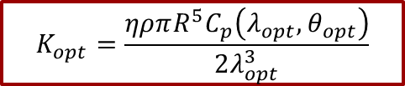
Region 2 controller design
$Q_{g}=f(Ω)$
Consider the power law and the optimal power
Substituting the tip-speed ratio
In terms of electrical power
Neglect transient response, then Qe becomes:
$$P=\frac{1}{2}ρπR^{2}v^{3}C_{p}\left(λ,θ\right)$$
$$P=\frac{1}{2}ρπR^{2}v^{3}C_{p,max}\left(λ_{opt},θ_{opt}\right)$$
$$P=\frac{1}{2}ρπR^{2}C_{p,max}\left(λ_{opt},θ_{opt}\right)\frac{R^{3}Ω^{3}}{λ_{opt}^{3}}$$
$Q_{g}$: generator torque at LSS
$η$: efficiency
$P={\frac{1}{η}P}_{g}=Q_{g}Ω$
$Q_{g}=\frac{ηρπR^{5}C_{p}\left(λ_{opt},θ_{opt}\right)}{2λ_{opt}^{3}}Ω^{2}=K_{opt}Ω^{2}$
$$K_{opt}=\frac{ηρπR^{5}C_{p}\left(λ_{opt},θ_{opt}\right)}{2λ_{opt}^{3}}$$

Slide 10
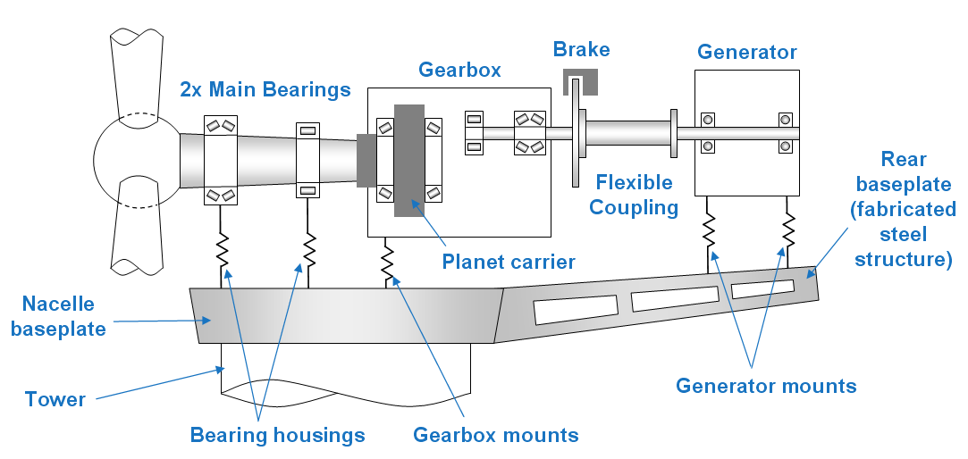

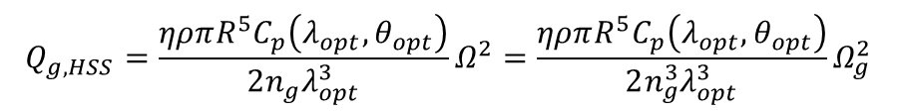
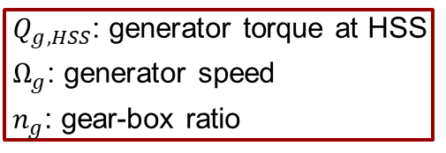
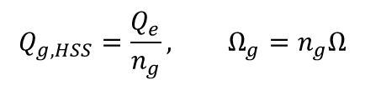
Region 2: Alternative form
On the Low-Speed Side (LSS)
On the High-Speed Side (HSS)
Thus,
$Q_{g}=\frac{ηρπR^{5}C_{p}\left(λ_{opt},θ_{opt}\right)}{2λ_{opt}^{3}}Ω^{2}=K_{opt}Ω^{2}$
$$Q_{g,HSS}=\frac{Q_{e}}{n_{g}}, Ω_{g}=n_{g}Ω$$
$Q_{g,HSS}$: generator torque at HSS
$Ω_{g}$: generator speed
$n_{g}$: gear-box ratio
$$Q_{g,HSS}=\frac{ηρπR^{5}C_{p}\left(λ_{opt},θ_{opt}\right)}{2n_{g}λ_{opt}^{3}}Ω^{2}=\frac{ηρπR^{5}C_{p}\left(λ_{opt},θ_{opt}\right)}{2n_{g}^{3}λ_{opt}^{3}}Ω_{g}^{2}$$
IMPORTANT
In the Matlab code, we consider the rotor speed and generator torque on the LSS.

Slide 11
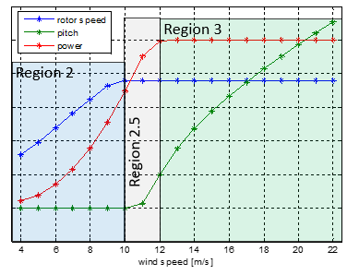
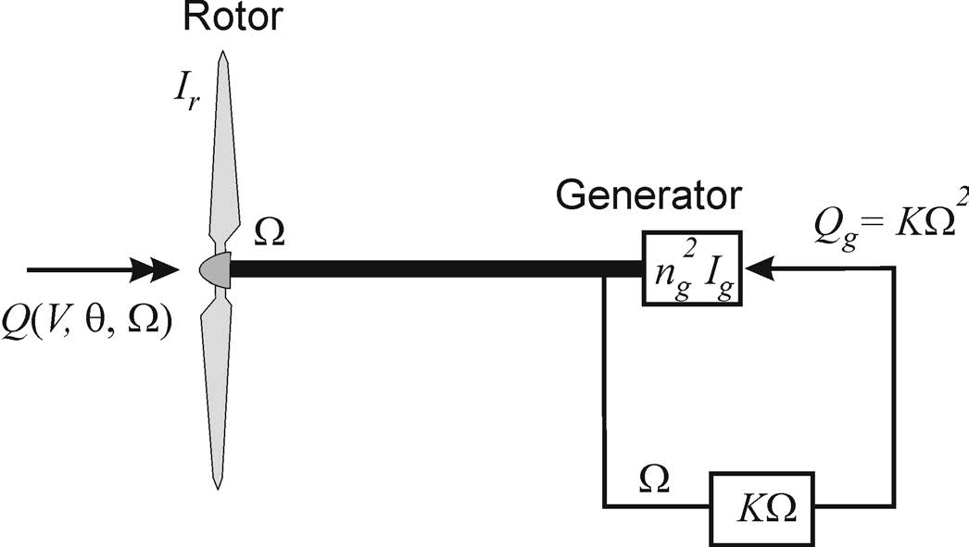

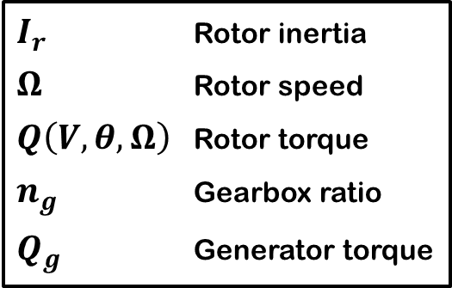
Region 2: Optimal Cp tracking
Region 1
Strategy: Keep pitch angle at optimum and use generator torque to obtain optimal tip speed ratio in a torque equilibrium
$${θ=θ}_{opt}$$
$I_{r}$ Rotor inertia
$Ω$ Rotor speed
$Q\left(V,θ,Ω\right)$ Rotor torque
$n_{g}$ Gearbox ratio
$Q_{g}$ Generator torque

Slide 12
Region 2: Derivation of generator torque constant
Go through derivation (Lecture notes)

Slide 13

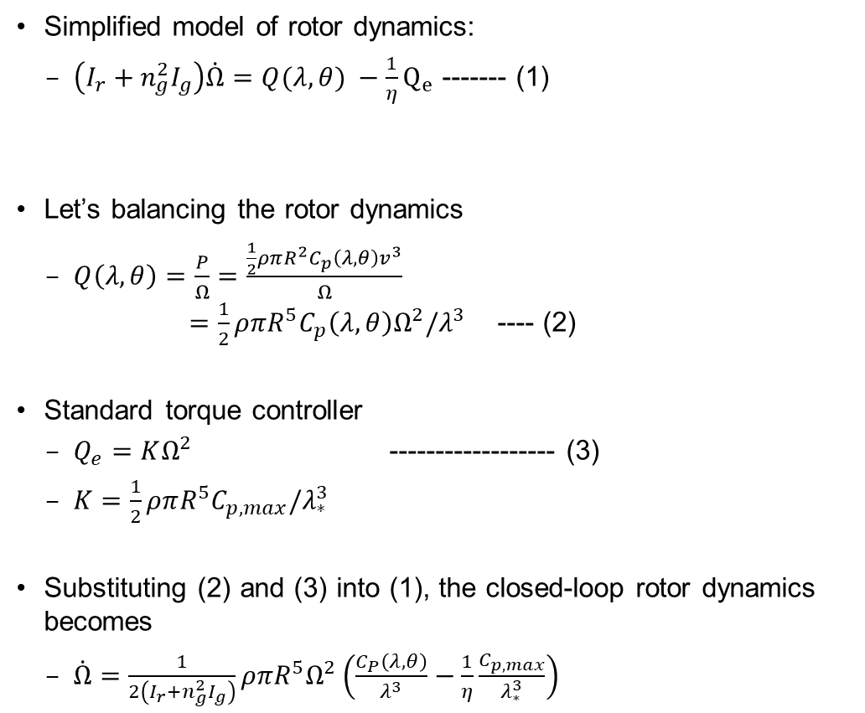
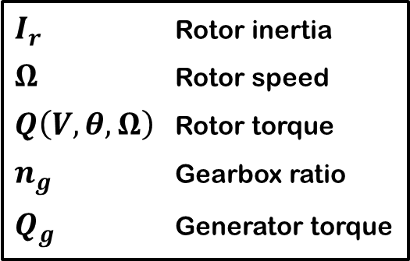
Region 2: Transient behaviour
Simplified model of rotor dynamics:
$\left(I_{r}+n_{g}^{2}I_{g}\right)\dot{Ω}=Q(λ,θ) −{\frac{1}{η}Q}_{e}$ ------- (1)
Let’s balancing the rotor dynamics
$Q\left(λ,θ\right)=\frac{P}{Ω}=\frac{\frac{1}{2}ρπR^{2}C_{p}\left(λ,θ\right)v^{3}}{Ω}$ $=\frac{1}{2}ρπR^{5}C_{p}\left(λ,θ\right)Ω^{2}/λ^{3}$ ---- (2)
Standard torque controller
$Q_{e}=KΩ^{2}$ ------------------ (3)
$K=\frac{1}{2}ρπR^{5}C_{p,max}/λ_{∗}^{3}$
Substituting (2) and (3) into (1), the closed-loop rotor dynamics becomes
$\dot{Ω}=\frac{1}{2\left(I_{r}+n_{g}^{2}I_{g}\right)}ρπR^{5}Ω^{2}\left(\frac{C_{P}\left(λ,θ\right)}{λ^{3}}−\frac{1}{η}\frac{C_{p,max}}{λ_{∗}^{3}}\right)$
Newton’s second law
$I_{r}$ Rotor inertia
$Ω$ Rotor speed
$Q\left(V,θ,Ω\right)$ Rotor torque
$n_{g}$ Gearbox ratio
$Q_{g}$ Generator torque
$$λ=ΩR/v$$

Slide 14


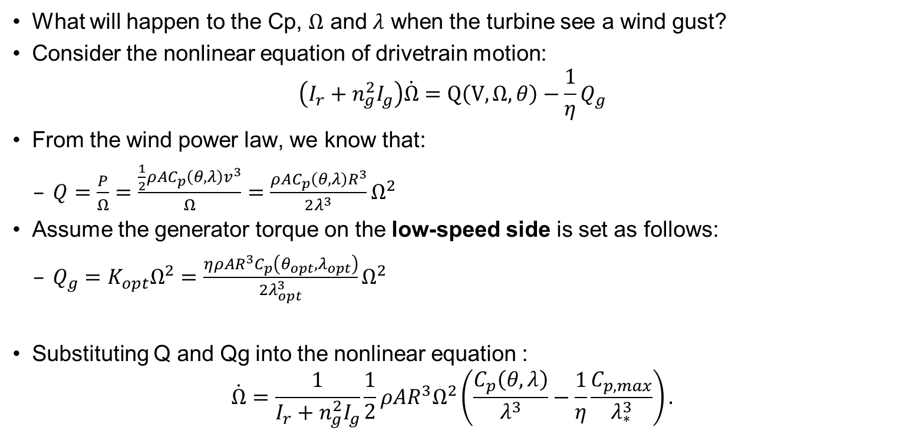
Region 2: Cp tracking – Transient behaviour
Newton’s second law
What will happen to the Cp, $Ω$ and $λ$ when the turbine see a wind gust?
Consider the nonlinear equation of drivetrain motion:
$$\left(I_{r}+n_{g}^{2}I_{g}\right)\dot{Ω}=Q\left(V,Ω,θ\right)−\frac{1}{η}Q_{g}$$
From the wind power law, we know that:
$Q=\frac{P}{Ω}=\frac{\frac{1}{2}ρAC_{p}\left(θ,λ\right)v^{3}}{Ω}=\frac{ρAC_{p}\left(θ,λ\right)R^{3}}{2λ^{3}}Ω^{2}$
Assume the generator torque on the low-speed side is set as follows:
$Q_{g}=K_{opt}Ω^{2}=\frac{ηρAR^{3}C_{p}\left(θ_{opt},λ_{opt}\right)}{2λ_{opt}^{3}}Ω^{2}$
Substituting Q and Qg into the nonlinear equation :
$$\dot{Ω}=\frac{1}{I_{r}+n_{g}^{2}I_{g}}\frac{1}{2}ρAR^{3}Ω^{2}\left(\frac{C_{p}\left(θ,λ\right)}{λ^{3}}−\frac{1}{η}\frac{C_{p,max}}{λ_{∗}^{3}}\right).$$
$I_{r}$ Rotor inertia
$I_{g}$ Generator inertia
$Ω$ Rotor speed
$Q\left(V,θ,Ω\right)$ Rotor torque
$n_{g}$ Gearbox ratio
$Q_{g}$ Generator torque
$$λ=ΩR/v$$

Slide 15
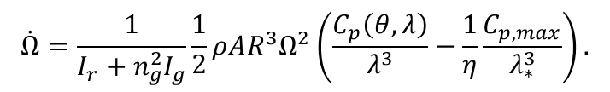

Region 2: Cp tracking - Analysis
$$\dot{Ω}=\frac{1}{I_{r}+n_{g}^{2}I_{g}}\frac{1}{2}ρAR^{3}Ω^{2}\left(\frac{C_{p}\left(θ,λ\right)}{λ^{3}}−\frac{1}{η}\frac{C_{p,max}}{λ_{∗}^{3}}\right).$$
Based on the nonlinear equation,
the rotor will accelerate $\dot{Ω}>0$ if $\frac{C_{p}\left(θ,λ\right)}{λ}>\frac{C_{p,max }}{λ_{∗}^{3}}$, or equivalently $C_{p}>\frac{1}{η}\frac{C_{p,max }}{λ_{∗}^{3}}λ^{3}$;
the rotor will decelerate $\dot{Ω}<0$ if $\frac{C_{p}\left(θ,λ\right)}{λ}<\frac{C_{p,max}}{λ_{∗}^{3}}$ , or equivalently $C_{p}<\frac{1}{η}\frac{C_{p,max }}{λ_{∗}^{3}}λ^{3}$;
the rotor will remain constant $\dot{Ω}=0$ if $\frac{C_{p}\left(θ,λ\right)}{λ}=\frac{C_{p,max}}{λ_{∗}^{3}}$ , or equivalently $C_{p}=\frac{1}{η}\frac{C_{p,max }}{λ_{∗}^{3}}λ^{3}$.

Slide 16
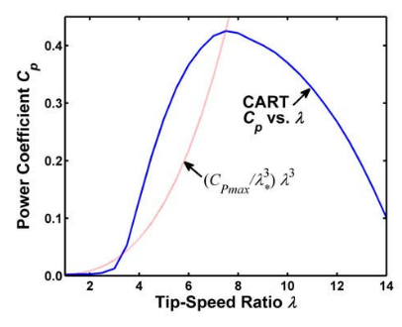





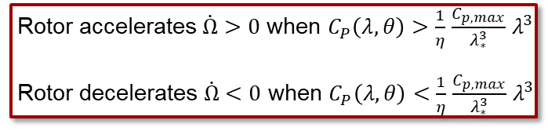

Region 2: Cp tracking - Transient behaviour
$${θ=θ}_{opt}$$
Cp surface
$$\dot{Ω}>0$$
$$\dot{Ω}<0$$
Region 2
Region 2.5
Cp
/$η$
Region 3
$$λ_{opt}$$
$$θ_{opt}$$
Rotor accelerates $\dot{Ω}>0$ when $C_{P}\left(λ,θ\right)>$ $\frac{1}{η}$ $\frac{C_{p,max}}{λ_{∗}^{3}}$ $λ^{3}$
Rotor decelerates $\dot{Ω}<0$ when $C_{P}\left(λ,θ\right)<$ $\frac{1}{η}$ $\frac{C_{p,max}}{λ_{∗}^{3}}$ $λ^{3}$

Slide 17
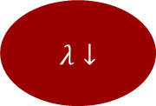

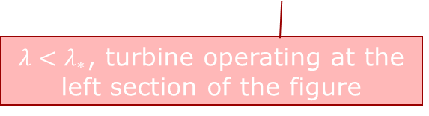

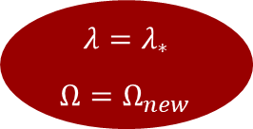
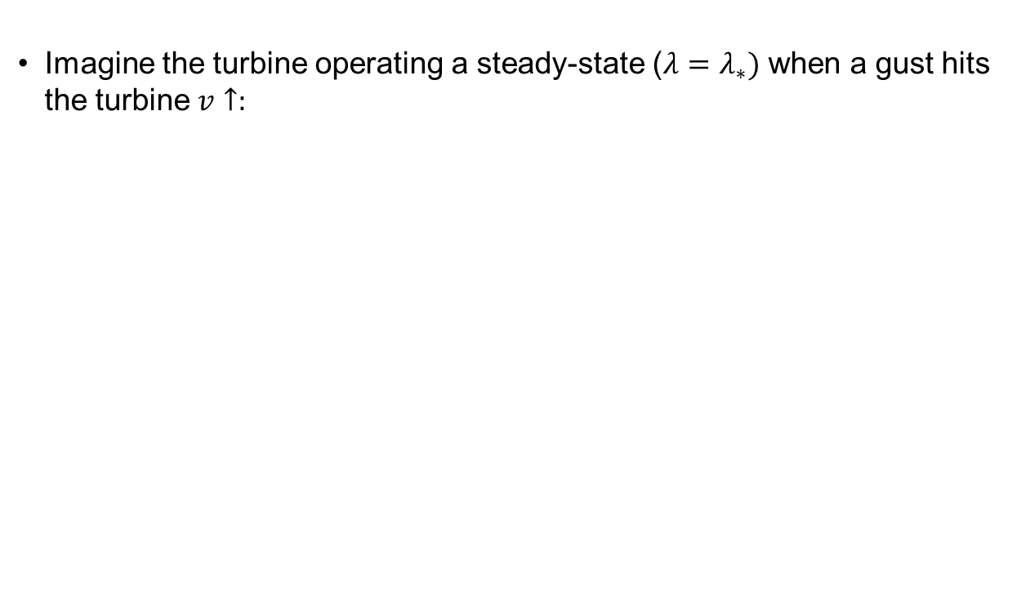
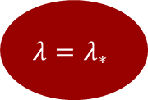
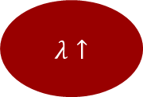

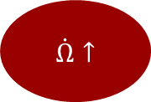
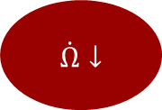
Region 2: Cp tracking - Analysis
Imagine the turbine operating a steady-state ($λ=λ_{∗})$ when a gust hits the turbine $v↑:$
Rotor speed does not change instantaneously due to large inertia
From the figure, we know that the rotor will accelerate
Higher rotor speed,
Higher torques,
Higher power
$$λ=λ_{∗}$$
$Ω=Ω_{new}$
if $λ=λ_{∗}$
$$λ=λ_{∗}$$
$$v↑$$
$$λ↓$$
$$\dot{Ω}↑$$
$$λ↑$$
if overshoot,
$$λ>λ_{∗}$$
From the figure, we know that the rotor will decelerate
$λ<λ_{∗}$, turbine operating at the left section of the figure
$$\dot{Ω}↓$$

Slide 18
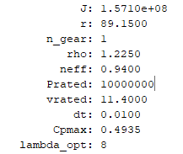
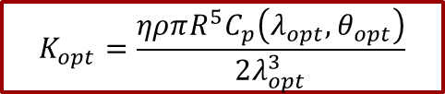
Region 2: Optimal Cp tracking
$$K_{opt}=\frac{ηρπR^{5}C_{p}\left(λ_{opt},θ_{opt}\right)}{2λ_{opt}^{3}}$$
Exercise: Region 2 controller
Open part_3.m, and run InitWT_10MW to find the parameters
Calculate the value for Kopt
Can you get the steady-state Cp value?
How close can you get to the actual optimal Cp,max?

Slide 19
Region 2: Optimal Cp tracking
Kopt = 9.8182e+06 Nm
Why Cp =/= Cp,max 0.4935?

Slide 20
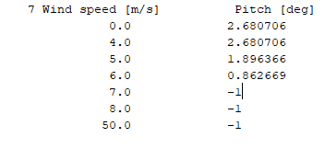


Region 1: Optimal Cp tracking
Because and $θ_{opt}=−1$ degree for this turbine model
$${θ=0≠θ}_{opt}$$
Exercise: Region 2 controller
In InitWT_10MW, change controller.minPitch = -1
In wpdata_DTU10MW.100, change it as follows.
Re-run part_3.m

Slide 21
Region 2: Optimal Cp tracking
Now, Cp = Cp,max (0.4935)

Slide 22
Summary
By now, we should be able to:
Explain the reason behind the generator torque controller design
Describe the generator torque design in Region 2
Calculate the gain for the generator torque controller

